Slide 1
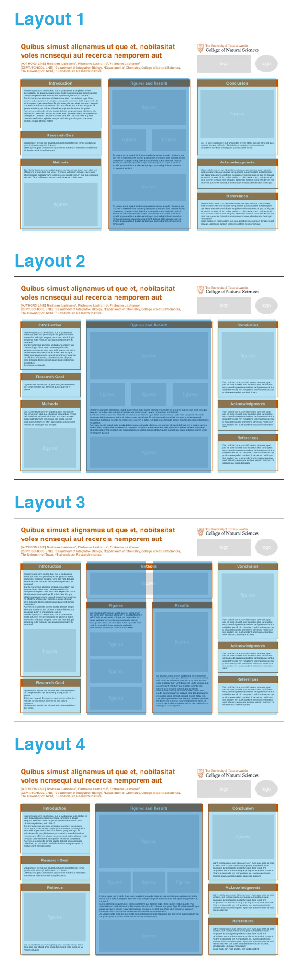
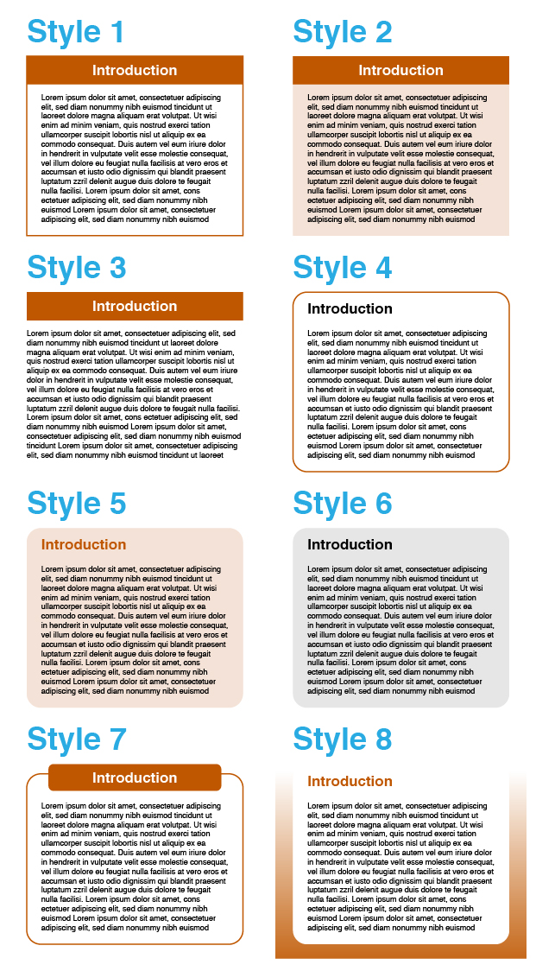
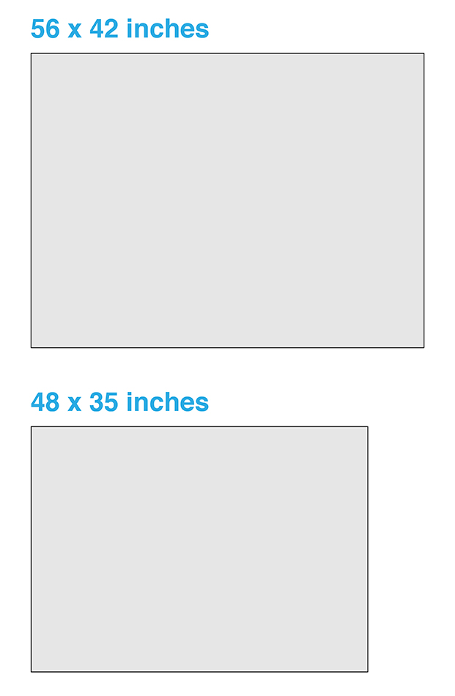
BEFORE YOU START
CHOOSE
A LAYOUT
Different forms/amounts of content might be suited to different column arrangements. These 4 layouts provide a choice of 3-column, 3-column with a wider middle column, a 4-column, and 4-column with the middle columns combined. Think about how your content will be organized and how much space you will need for introductory and concluding information versus data/figures. These options are all provided in this template file.
CHOOSE A SIZE
These templates are available in two sizes, one (larger) is the recommended size for the Undergraduate Research Forum, and one (smaller) might be better for traveling, as it fits in a 3ft poster tube. If you need the other size, download the other template file.
CHOOSE A STYLE
There are 8 different ‘cell’ styles, with various approaches to the headers and border or background. These options are all provided in this template file.
THIS FILE
NEXT
Once you’ve chosen the template page that best suits your project, delete other template pages (it might be helpful to keep the following basic tips pages for reference while editing) and save the file under a new name.
OTHER TEMPLATE FILE

Slide 2

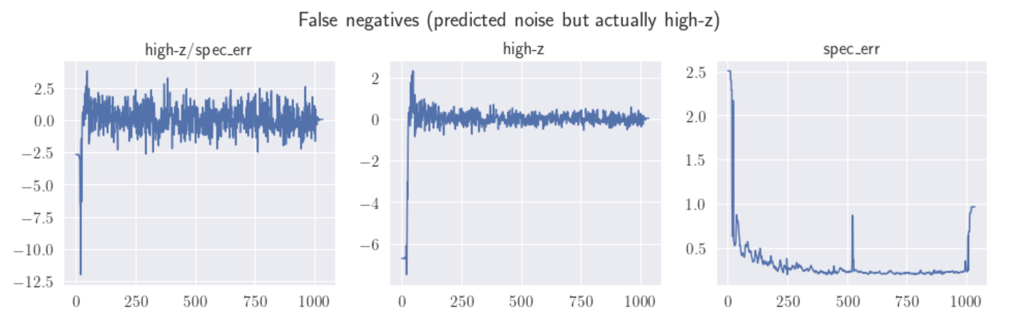


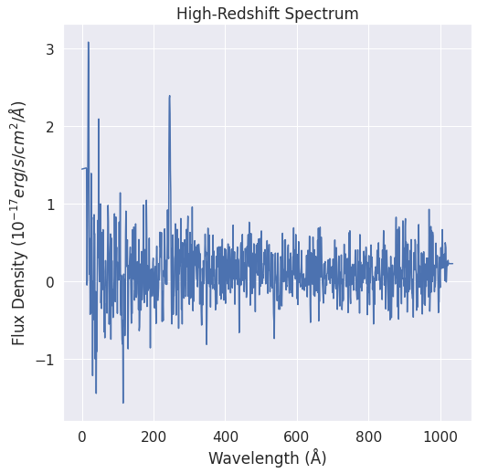
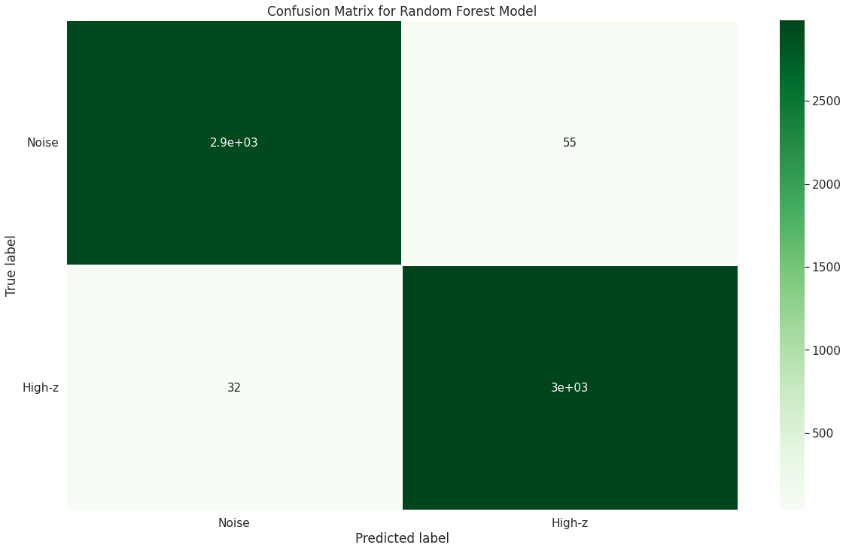
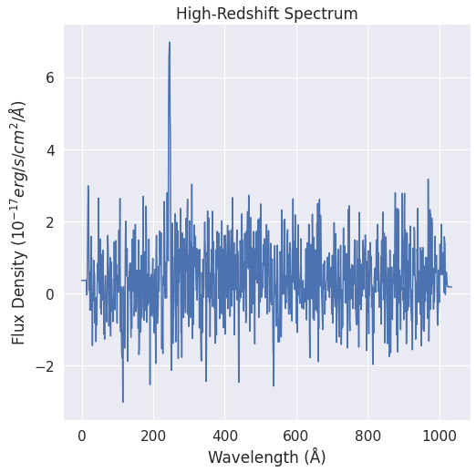
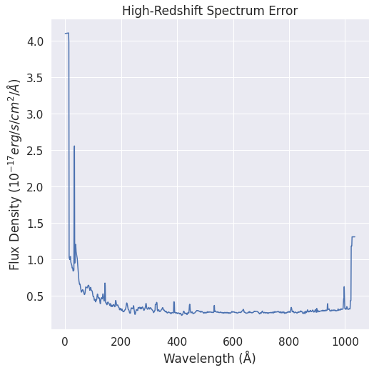
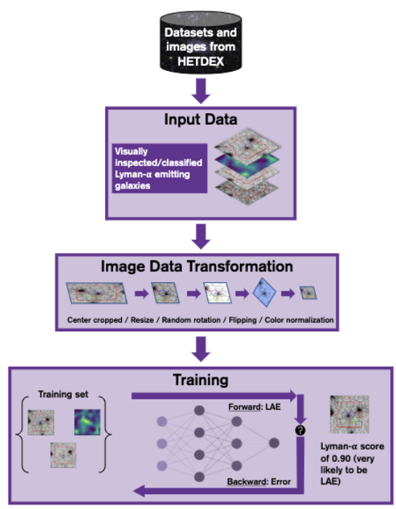
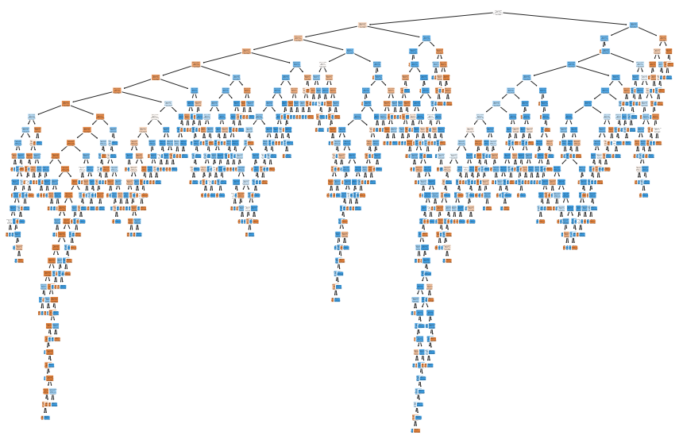
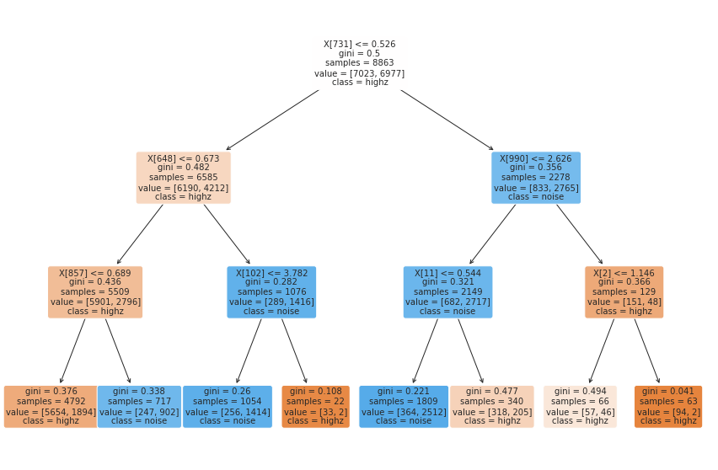
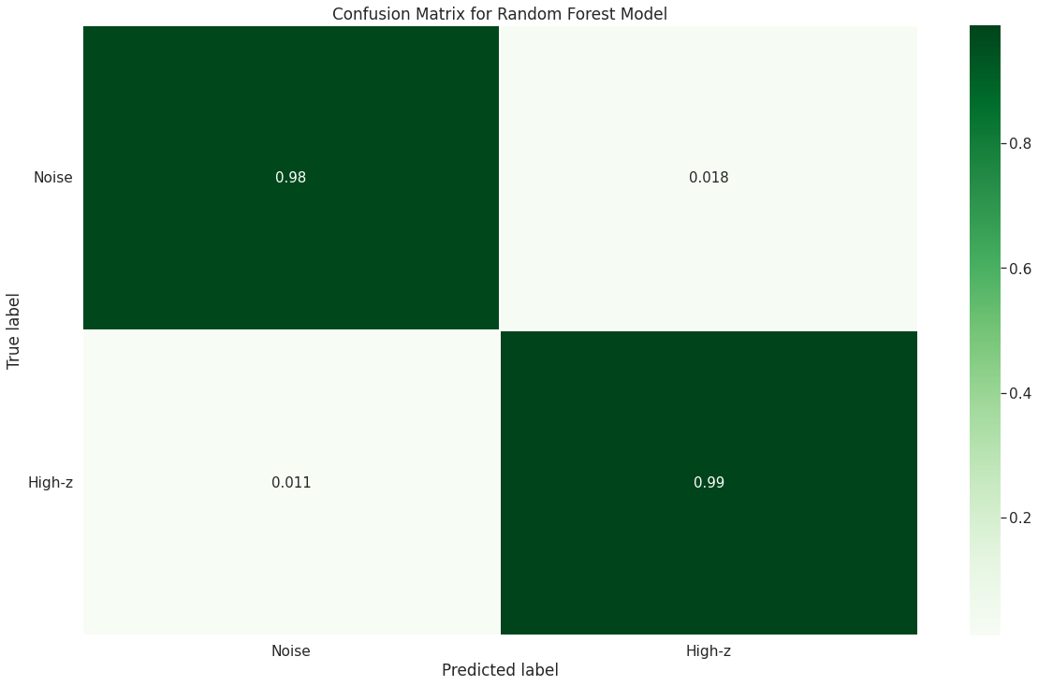
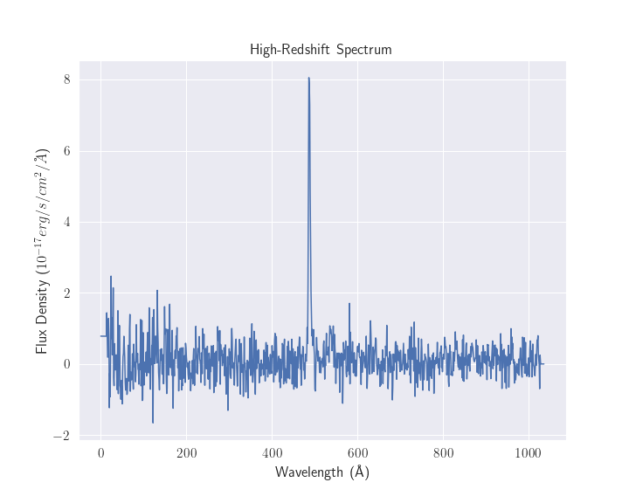
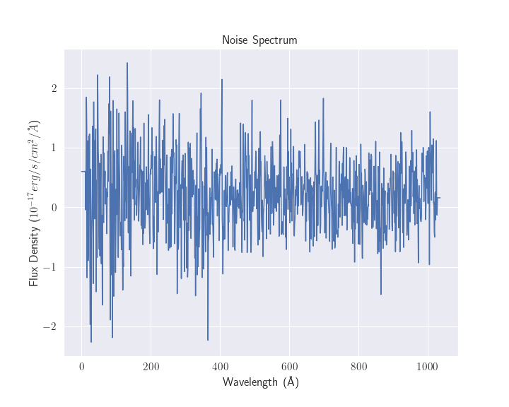
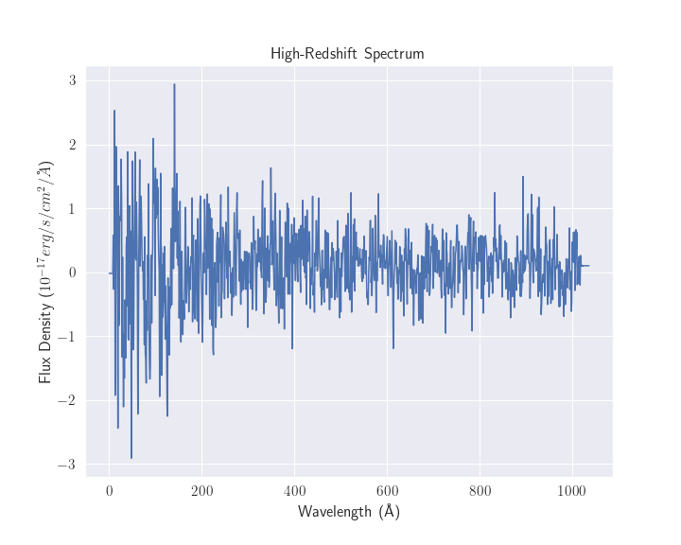
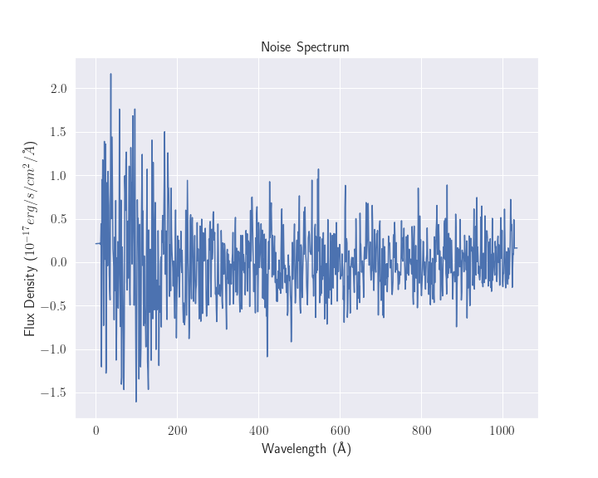
Classifying High-Redshift Galaxies from the HETDEX Survey Using a Random Forest Classifier
Nicholas Davila¹, Oscar Chavez², Gene Leung², Steven Finkelstein² ¹Department of Physics, College of Natural Sciences, The University of Texas
²Department of Astronomy, College of Natural Sciences, The University of Texas
Abstract
Methods and Results
Results
We trained a machine learning algorithm to autonomously classify large astronomical datasets for high-redshift galaxies. We used raw data from the Hobby-Eberly Telescope Dark Energy Experiment (HETDEX) third internal data release (HDR3) and extracted light spectra to train a Random Forest classification algorithm. We manipulated the spectral data to construct a sample of 10,000 true astrophysical spectra (high-redshift sources) and 10,000 noise sources. The high-redshift data set was constructed by using visually inspected spectra from the GEVIP internal HETDEX detections catalog. The noise sample was constructed by extracting spectra at random positions in the sky where there were no astrophysical objects within 200 arcseconds of the location of extraction. Both samples were then combined into a single dataset and labeled. We labeled a high-redshift source as a ‘1’ and a noise source was labeled a ‘0’. Using the ‘sklearn’ package, the entire dataset was split into 70% training and 30% testing sets. The algorithm was trained on the training set, and then employed to classify a source as either a ‘1’ or a ‘0’ in the testing set. The algorithm was able to achieve an accuracy of ~98.55% in its classification predictions with a precision of ~98.19% and a recall of ~98.94%.
Data Selection
Extracted 10,000 ‘high-confidence’ high-redshift spectral data from a GEVIP HETDEX detection catalog based on signal-to-noise ratio values greater than 7 and a pLya score larger than 0.95
Extracted 10,000 noise sources spectral data at random locations in the sky after checking that there we no sources within 200 arcseconds of the extraction point
Data Manipulation
Removed noisy areas from high-redshift sources by dividing the sources by their respective spectral error
Combined the noise and high-redshift data sets into one large 20,000 sized data set and labeled high-redshift sources as ‘1’ and noise sources as ‘0.’
Using sklearn train_test_split the data was split into 70% training and 30% testing sets
Figure 2: Schematic of data manipulation process. In order to de-noise the data, high-redshift spectra were divided by the spectrum error. In the schematic, the top left spectra is divided by the bottom left. The resulting spectra is shown on the right.
Figure 4: Confusion matrix for the Random Forest model. The top left square tells us our true negatives (predicted noise classified correctly as noise). The bottom right square tell us our true positives (predicted high-redshift classified correctly as high redshift). The top right square tells us our false positives (predicted high-redshift but is noise), and the bottom left square tells us our false negatives (predicted noise but is high-redshift).
We split the combined 20,000 sized data into a 70% training and 30% testing set. Out of the 6,000 sources that were in the testing set, 2985 were correctly identified as high-redshift, 2928 were correctly identified as noise, 55 were high-redshift sources incorrectly identified as noise and 32 were noise sources incorrectly identifies as high-redshift.
Motivation
Machine learning methods like clustering and classification are very popular in the astronomy machine learning community. However, many ML algorithms struggle with differentiating between noise spectra and true astrophysical (high-redshift in this case) spectra. The motivation for this project was to implement an algorithm that focused on solving the astrophysical source vs. noise problem specifically. This will allow for more high-redshift sources to be studied, which will help us learn more about the period of reionization in the universal timeline.
Conclusion
We trained a Random Forest machine learning algorithm to distinguish between true astrophysical spectra and noise spectra. First, we extracted raw data and reduced the noise of our target data by dividing spectral error data out of the true astrophysical data. Applying the random forest classifier on the denoised data allowed us to achieve a classification accuracy of ~98.55%. In the future, this algorithm could be used to support algorithms which usually suffer with high-redshift vs. noise classification.
References
Figure 3: On the top left is a zoomed-out plot of the first decision tree created by our random forest classification algorithm (out of 700 total). The bottom right plot is a zoomed-in plot into the tree where the information on why splits were made is visible. The first line in all the boxes is the feature name with the split value. The split value is decided by the algorithm after selecting a threshold value which gives the highest information gain for that split. The second line ‘gini’ is the deciding factor to select the best split value or select the feature at the next node etc. The third line ‘samples’ is the remaining number of samples at that particular node. The fourth line ‘values’ is the number of each class remaining at that particular node.
Gebhardt, Karl, et al. "The Hobby–Eberly telescope dark energy experiment (HETDEX) survey design, reductions, and detections." The Astrophysical Journal 923.2 (2021): 217.
Strengths:
RF is an ensemble learning method which combines multiple different techniques (sometimes per each node) to improve accuracy
Very robust to outliers and overfitting
Easy to implement and popular so there is a lot of documentation for help
Weaknesses:
Computationally expensive and slow when more trees and data are involved
Very dependent on the amount of data had. Clear increasing trend between higher accuracy and larger amount of data
Difficult to interpret hundreds of trees/decisions
Acknowledgments
Thank you to Oscar Chavez, Dr. Steven Finkelstein, Dr. Gene Leung, and GEVIP for their support throughout my research. The Vertically Integrated Project (VIP): Galaxy Evolution group gratefully acknowledges the support from National Science Foundation (NSF) grant AST-1908817.
Figure 1: The left plots with the green outline are spectral plots of high-redshift true astrophysical objects. The green is to highlight that those are the spectral plots we want. The right plots with red outlines are spectral plots of noise. The red outline is to highlight that (ultimately) we do not want those, since studying noise is not interesting to us right now.

Slide 3
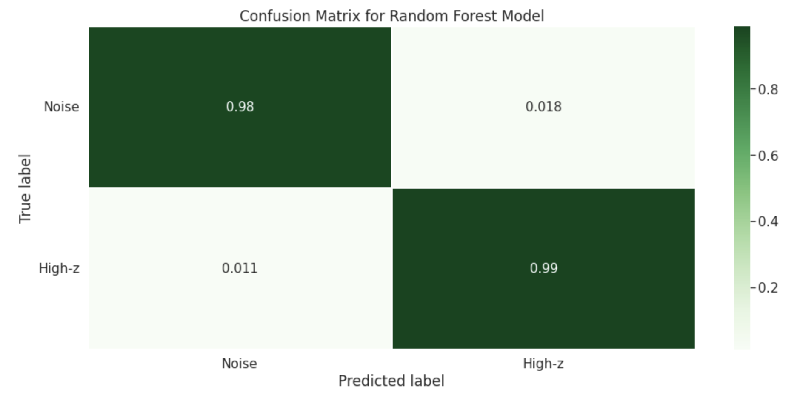
Classifying High-Redshift Galaxies from the HETDEX Survey Using a Random Forest Classifier
Nicholas Davila¹, Oscar Chavez², Gene Leung², Steven Finkelstein² ¹Department of Physics, College of Natural Sciences, The University of Texas
²Department of Astronomy, College of Natural Sciences, The University of Texas
Introduction
Methods and Results
Results
We aim to train a machine learning algorithm that could autonomously classify large astronomical datasets for high-redshift galaxies. We used raw data from the Hobby-Eberly Telescope Dark Energy Experiment (HETDEX) third internal data release (HDR3) and extracted light spectra to train a machine learning algorithm. We manipulated data to construct a sample of 10,000 high-redshift sources and 10,000 noise sources. The high-redshift sample was constructed by extracting spectra at random positions in the sky given certain criteria were met that are known to be attributed to high-redshift galaxies. The noise sample was constructed by extracting spectra at random positions in the sky where there were no objects within 200 arcseconds of the location of extraction. Both samples were then combined into a single dataset and labeled. For this dataset, we label a high-redshift source as a ‘1’ and a label of ‘0’ is a noise source. Using the sklearn package, the entire dataset was split into training and testing sets. A random forest machine learning algorithm was employed to classify the sources as either a 1 or a 0. The algorithm was trained on the training set, and then used for classifications in the testing set. The algorithm achieved an approximate ~98.55% accuracy in its predictions with a precision of ~98.19% and a recall of ~98.94%.
Data Selection
Sss
S
S
Data Normalizing? Manipulation?
Sss
Ss
ss
figures
Vitam voloria con et, cum laboreium, nam cum, quat paris as core volorest, sust exceatur antio ea voluptas eumquatendit quas doluptatet aut landignam que lantur sania dem escidit min reruptiaero velis maximus aut que pe aliquas sequidisit, omnient
Motivation
Conclusion
Machine learning methods like clustering and classification are popular and widespread in the astronomy community. However, many machine learning algorithms struggle with differentiating between noise spectra and high-z spectra. My motivation was to implement an algorithm that focused on solving that problem specifically.
Conclusion and future work.
Acknowledgments
Imintem quas porro debitis itius, nus id quat animus auda platust et imin perovitasped es ipsus mo maios eume di ut a dolupit, sequam, serio bea natis dolupta simperiae nate molorum eati ulparis magnieniam, to intotatur?
Sunto into temperi aturerum et identio nsectatem quo dolorum fuga. Itiatur, quam vendus quodis reria volupienis con posto dolor sam debit experumet odit ut id molorrum que quam fuga. Et volorioraes alit, que plitati onemporro entorio rumendi simenimus mossimus re officit mo officae etur, volorem et optae. Ut ipsam esto temquas dolores sitiandi arum ipicien debisimus doluptatius.
As verepe sectis enda di incto etusda delectet eaque simusda ndanimus, sin cori rem id maximillut hari con ea quiam quam et enduci idunt, corecta alicimp oriaeperum iusaeped unt quis et ut abor ame alis utatur as senet a quibus dolutatur sedit aliam apienda versper feriti delia pa dolo quamus arum es endellu pisquia aditatur audam earupid quo quunt odigniscil earum verios nonsequam duciis et
Thank you to Dr. Steven Finkelstein for supervising my project, as well as to Oscar Chavez and Dr. Gene Leung for their support and feedback throughout my research. Thank you to all my lab peers for their encouragement.

Slide 4
Classifying High-Redshift Galaxies from the HETDEX Survey Using a Random Forest Classifier
logo
logo
[AUTHORS LINE] Firstname Lastname¹, Firstname Lastname², Firstname Lastname³ [DEPT./SCHOOL LINE] ¹Department of Integrative Biology, ²Department of Chemistry, College of Natural Sciences, The University of Texas, ³Suchandsuch Research Institute
Introduction
Figures and Results
Conclusion
Imintem quas porro debitis itius, nus id quat animus auda platust et imin perovitasped es ipsus mo maios eume di ut a dolupit, sequam, serio bea natis dolupta simperiae nate molorum eati ulparis magnieniam, to intotatur?
Sunto into temperi aturerum et identio nsectatem quo dolorum fuga. Itiatur, quam vendus quodis reria volupienis con posto dolor sam debit experumet odit ut id molorrum que quam fuga. Et volorioraes alit, que plitati onemporro entorio rumendi simenimus mossimus re officit mo officae etur, volorem et optae. Ut ipsam esto temquas dolores sitiandi arum ipicien debisimus doluptatius.
As verepe sectis enda di incto etusda delectet eaque simusda ndanimus, sin cori rem id maximillut hari con ea quiam quam et enduci idunt, corecta
figures
figures
Research Goal
Ugiatempore evenis rae doluptatum fugiam earchitiam dit, tempe susdam qui asimin et quissequam la ni ipsunt.
Ditat que a quibus dolutatur sedit aliam apienda versper feriti delia pa dolo quamus arum es endellu pisquia aditatur audam earupid quo
figures
figures
figures
Vitam voloria con et, cum laboreium, nam cum, quat paris as core volorest, sust exceatur antio ea voluptas eumquatendit quas doluptatet aut landignam que lantur sania dem escidit min reruptiaero velis maximus aut que pe aliquas sequidisit, omnient
Methods
Acknowledgments
Ga. Oviduntusam exerum fugitat quae el exersperum qui corum sam sitas que officiat am el inust dunt mint ut vel il mintis es vel maxim dolupiet, aut quatur aborem quiae explitatur sum venihit quo con cusda volorum quia qui conessunt vel etur? Quis nullitae porunto mod maiorio ex es dolupis eum
Imintem quas porro debitis itius, nus id quat animus auda platust et imin perovitasped es ipsus mo maios eume di ut a dolupit, sequam, serio bea natis dolupta simperiae nate molorum eati ulparis magnieniam, to intotatur?
Sunto into temperi aturerum et identio nsectatem quo dolorum fuga. Itiatur, quam vendus quodis reria volupienis con posto dolor sam debit experumet odit ut id molorrum que quam fuga. Et volorioraes alit, que plitati onemporro entorio rumendi simenimus mossimus re officit mo officae etur, volorem et optae. Ut ipsam esto temquas dolores sitiandi arum ipicien debisimus doluptatius.
As verepe sectis enda di incto etusda delectet eaque simusda ndanimus, sin cori rem id maximillut hari con ea quiam quam et enduci idunt, corecta alicimp oriaeperum iusaeped unt quis et ut abor ame alis utatur as senet a quibus dolutatur sedit aliam apienda versper feriti delia pa dolo quamus arum es endellu pisquia aditatur audam earupid quo quunt odigniscil earum verios nonsequam duciis et
Vitam voloria con et, cum laboreium, nam cum, quat paris as core volorest, sust exceatur antio ea voluptas eumquatendit quas doluptatet aut landignam que lantur sania dem escidit min reruptiaero velis maximus aut que pe aliquas sequidisit, omnient hit lam eicias modio con nisin pediam, ent, cust accaborit odio corehen dendae nonet eliquam, aperorepe autatem
figures
figures
References
Vitam voloria con et, cum laboreium, nam cum, quat paris as core volorest, sust exceatur antio ea voluptas eumquatendit quas doluptatet aut landignam que lantur sania dem escidit min reruptiaero velis maximus aut que pe aliquas sequidisit, omnient hit lam eicias modio con nisin pediam, ent, cust accaborit odio corehen dendae nonet eliquam, aperorepe autatem voles int odic tem nis dolorrum que cores doluptaturi

Slide 5
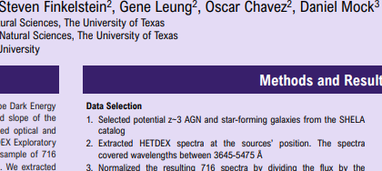
Classifying High-Redshift Galaxies from the HETDEX Survey Using a Random Forest Classifier
logo
logo
[AUTHORS LINE] Firstname Lastname¹, Firstname Lastname², Firstname Lastname³ [DEPT./SCHOOL LINE] ¹Department of Integrative Biology, ²Department of Chemistry, College of Natural Sciences, The University of Texas, ³Suchandsuch Research Institute
Introduction
Figures and Results
Conclusion
Imintem quas porro debitis itius, nus id quat animus auda platust et imin perovitasped es ipsus mo maios eume di ut a dolupit, sequam, serio bea natis dolupta simperiae nate molorum eati ulparis magnieniam, to intotatur?
Sunto into temperi aturerum et identio nsectatem quo dolorum fuga. Itiatur, quam vendus quodis reria volupienis con posto dolor sam debit experumet odit ut id molorrum que quam fuga. Et volorioraes alit, que plitati onemporro entorio rumendi simenimus mossimus re officit mo officae etur, volorem et optae. Ut ipsam esto temquas dolores sitiandi arum ipicien debisimus doluptatius.
As verepe sectis enda di incto etusda delectet eaque simusda ndanimus, sin cori rem id maximillut hari con ea quiam quam et enduci idunt, corecta
figures
figures
Research Goal
Ugiatempore evenis rae doluptatum fugiam earchitiam dit, tempe susdam qui asimin et quissequam la ni ipsunt.
Ditat que a quibus dolutatur sedit aliam apienda versper feriti delia pa dolo quamus arum es endellu pisquia aditatur audam earupid quo
figures
figures
figures
Vitam voloria con et, cum laboreium, nam cum, quat paris as core volorest, sust exceatur antio ea voluptas eumquatendit quas doluptatet aut landignam que lantur sania dem escidit min reruptiaero velis maximus aut que pe aliquas sequidisit, omnient
Methods
Acknowledgments
Ga. Oviduntusam exerum fugitat quae el exersperum qui corum sam sitas que officiat am el inust dunt mint ut vel il mintis es vel maxim dolupiet, aut quatur aborem quiae explitatur sum venihit quo con cusda volorum quia qui conessunt vel etur? Quis nullitae porunto mod maiorio ex es dolupis eum
Imintem quas porro debitis itius, nus id quat animus auda platust et imin perovitasped es ipsus mo maios eume di ut a dolupit, sequam, serio bea natis dolupta simperiae nate molorum eati ulparis magnieniam, to intotatur?
Sunto into temperi aturerum et identio nsectatem quo dolorum fuga. Itiatur, quam vendus quodis reria volupienis con posto dolor sam debit experumet odit ut id molorrum que quam fuga. Et volorioraes alit, que plitati onemporro entorio rumendi simenimus mossimus re officit mo officae etur, volorem et optae. Ut ipsam esto temquas dolores sitiandi arum ipicien debisimus doluptatius.
As verepe sectis enda di incto etusda delectet eaque simusda ndanimus, sin cori rem id maximillut hari con ea quiam quam et enduci idunt, corecta alicimp oriaeperum iusaeped unt quis et ut abor ame alis utatur as senet a quibus dolutatur sedit aliam apienda versper feriti delia pa dolo quamus arum es endellu pisquia aditatur audam earupid quo quunt odigniscil earum verios nonsequam duciis et
Vitam voloria con et, cum laboreium, nam cum, quat paris as core volorest, sust exceatur antio ea voluptas eumquatendit quas doluptatet aut landignam que lantur sania dem escidit min reruptiaero velis maximus aut que pe aliquas sequidisit, omnient hit lam eicias modio con nisin pediam, ent, cust accaborit odio corehen dendae nonet eliquam, aperorepe autatem
figures
figures
References
Vitam voloria con et, cum laboreium, nam cum, quat paris as core volorest, sust exceatur antio ea voluptas eumquatendit quas doluptatet aut landignam que lantur sania dem escidit min reruptiaero velis maximus aut que pe aliquas sequidisit, omnient hit lam eicias modio con nisin pediam, ent, cust accaborit odio corehen dendae nonet eliquam, aperorepe autatem voles int odic tem nis dolorrum que cores doluptaturi

Slide 6
Classifying High-Redshift Galaxies from the HETDEX Survey Using Machine Learning
logo
logo
[AUTHORS LINE] Firstname Lastname¹, Firstname Lastname², Firstname Lastname³ [DEPT./SCHOOL LINE] ¹Department of Integrative Biology, ²Department of Chemistry, College of Natural Sciences, The University of Texas, ³Suchandsuch Research Institute
Introduction
Figures and Results
Conclusion
Imintem quas porro debitis itius, nus id quat animus auda platust et imin perovitasped es ipsus mo maios eume di ut a dolupit, sequam, serio bea natis dolupta simperiae nate molorum eati ulparis magnieniam, to intotatur?
Sunto into temperi aturerum et identio nsectatem quo dolorum fuga. Itiatur, quam vendus quodis reria volupienis con posto dolor sam debit experumet odit ut id molorrum que quam fuga. Et volorioraes alit, que plitati onemporro entorio rumendi simenimus mossimus re officit mo officae etur, volorem et optae. Ut ipsam esto temquas dolores sitiandi arum ipicien debisimus doluptatius.
As verepe sectis enda di incto etusda delectet eaque simusda ndanimus, sin cori rem id maximillut hari con ea quiam quam et enduci idunt, corecta
figures
figures
Research Goal
Ugiatempore evenis rae doluptatum fugiam earchitiam dit, tempe susdam qui asimin et quissequam la ni ipsunt.
Ditat que a quibus dolutatur sedit aliam apienda versper feriti delia pa dolo quamus arum es endellu pisquia aditatur audam earupid quo
figures
figures
figures
Vitam voloria con et, cum laboreium, nam cum, quat paris as core volorest, sust exceatur antio ea voluptas eumquatendit quas doluptatet aut landignam que lantur sania dem escidit min reruptiaero velis maximus aut que pe aliquas sequidisit, omnient
Methods
Acknowledgments
Ga. Oviduntusam exerum fugitat quae el exersperum qui corum sam sitas que officiat am el inust dunt mint ut vel il mintis es vel maxim dolupiet, aut quatur aborem quiae explitatur sum venihit quo con cusda volorum quia qui conessunt vel etur? Quis nullitae porunto mod maiorio ex es dolupis eum
Imintem quas porro debitis itius, nus id quat animus auda platust et imin perovitasped es ipsus mo maios eume di ut a dolupit, sequam, serio bea natis dolupta simperiae nate molorum eati ulparis magnieniam, to intotatur?
Sunto into temperi aturerum et identio nsectatem quo dolorum fuga. Itiatur, quam vendus quodis reria volupienis con posto dolor sam debit experumet odit ut id molorrum que quam fuga. Et volorioraes alit, que plitati onemporro entorio rumendi simenimus mossimus re officit mo officae etur, volorem et optae. Ut ipsam esto temquas dolores sitiandi arum ipicien debisimus doluptatius.
As verepe sectis enda di incto etusda delectet eaque simusda ndanimus, sin cori rem id maximillut hari con ea quiam quam et enduci idunt, corecta alicimp oriaeperum iusaeped unt quis et ut abor ame alis utatur as senet a quibus dolutatur sedit aliam apienda versper feriti delia pa dolo quamus arum es endellu pisquia aditatur audam earupid quo quunt odigniscil earum verios nonsequam duciis et
Vitam voloria con et, cum laboreium, nam cum, quat paris as core volorest, sust exceatur antio ea voluptas eumquatendit quas doluptatet aut landignam que lantur sania dem escidit min reruptiaero velis maximus aut que pe aliquas sequidisit, omnient hit lam eicias modio con nisin pediam, ent, cust accaborit odio corehen dendae nonet eliquam, aperorepe autatem
figures
figures
References
Vitam voloria con et, cum laboreium, nam cum, quat paris as core volorest, sust exceatur antio ea voluptas eumquatendit quas doluptatet aut landignam que lantur sania dem escidit min reruptiaero velis maximus aut que pe aliquas sequidisit, omnient hit lam eicias modio con nisin pediam, ent, cust accaborit odio corehen dendae nonet eliquam, aperorepe autatem voles int odic tem nis dolorrum que cores doluptaturi

Slide 7
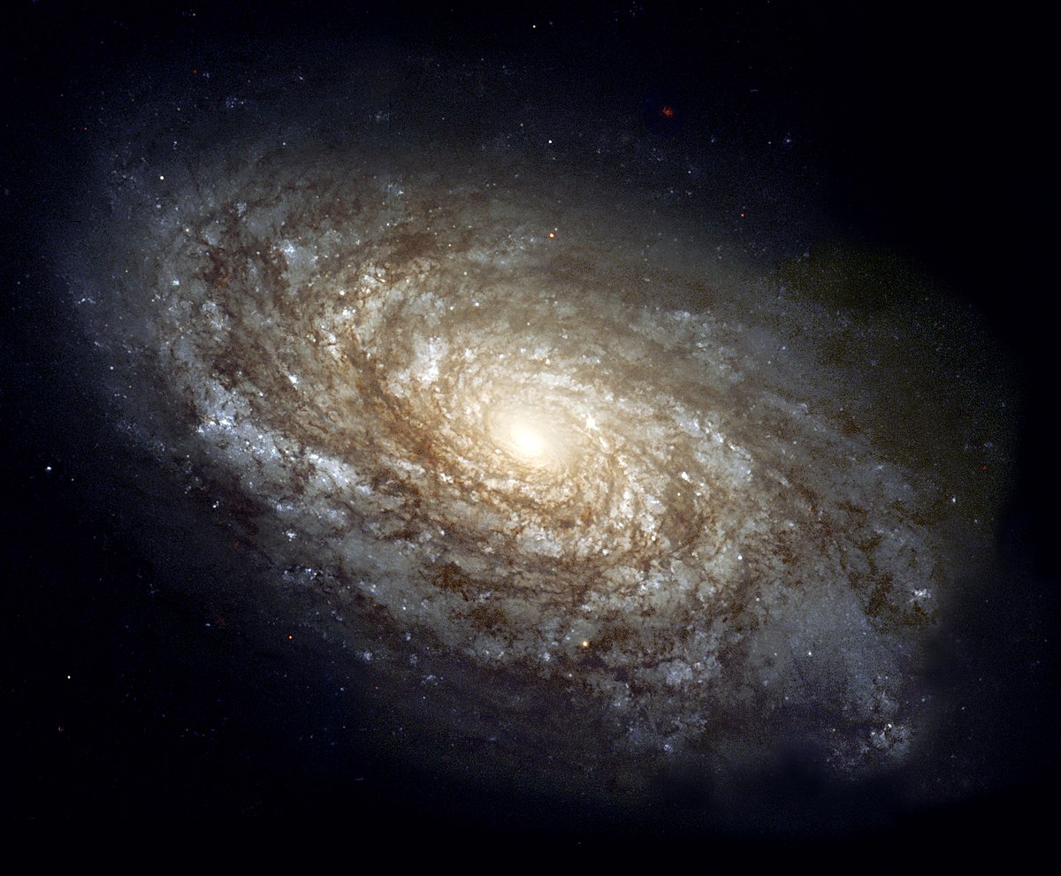
Classifying High-Redshift Galaxies from the HETDEX Survey Using a Random Forest Classifier
logo
logo
[AUTHORS LINE] Firstname Lastname¹, Firstname Lastname², Firstname Lastname³ [DEPT./SCHOOL LINE] ¹Department of Integrative Biology, ²Department of Chemistry, College of Natural Sciences, The University of Texas, ³Suchandsuch Research Institute
Introduction
Figures and Results
Conclusion
Imintem quas porro debitis itius, nus id quat animus auda platust et imin perovitasped es ipsus mo maios eume di ut a dolupit, sequam, serio bea natis dolupta simperiae nate molorum eati ulparis magnieniam, to intotatur?
Sunto into temperi aturerum et identio nsectatem quo dolorum fuga. Itiatur, quam vendus quodis reria volupienis con posto dolor sam debit experumet odit ut id molorrum que quam fuga. Et volorioraes alit, que plitati onemporro entorio rumendi simenimus mossimus re officit mo officae etur, volorem et optae. Ut ipsam esto temquas dolores sitiandi arum ipicien debisimus doluptatius.
As verepe sectis enda di incto etusda delectet eaque simusda ndanimus, sin cori rem id maximillut hari con ea quiam quam et enduci idunt, corecta
figures
figures
Research Goal
Ugiatempore evenis rae doluptatum fugiam earchitiam dit, tempe susdam qui asimin et quissequam la ni ipsunt.
Ditat que a quibus dolutatur sedit aliam apienda versper feriti delia pa dolo quamus arum es endellu pisquia aditatur audam earupid quo
figures
figures
figures
Vitam voloria con et, cum laboreium, nam cum, quat paris as core volorest, sust exceatur antio ea voluptas eumquatendit quas doluptatet aut landignam que lantur sania dem escidit min reruptiaero velis maximus aut que pe aliquas sequidisit, omnient
Methods
Acknowledgments
Ga. Oviduntusam exerum fugitat quae el exersperum qui corum sam sitas que officiat am el inust dunt mint ut vel il mintis es vel maxim dolupiet, aut quatur aborem quiae explitatur sum venihit quo con cusda volorum quia qui conessunt vel etur? Quis nullitae porunto mod maiorio ex es dolupis eum
Imintem quas porro debitis itius, nus id quat animus auda platust et imin perovitasped es ipsus mo maios eume di ut a dolupit, sequam, serio bea natis dolupta simperiae nate molorum eati ulparis magnieniam, to intotatur?
Sunto into temperi aturerum et identio nsectatem quo dolorum fuga. Itiatur, quam vendus quodis reria volupienis con posto dolor sam debit experumet odit ut id molorrum que quam fuga. Et volorioraes alit, que plitati onemporro entorio rumendi simenimus mossimus re officit mo officae etur, volorem et optae. Ut ipsam esto temquas dolores sitiandi arum ipicien debisimus doluptatius.
As verepe sectis enda di incto etusda delectet eaque simusda ndanimus, sin cori rem id maximillut hari con ea quiam quam et enduci idunt, corecta alicimp oriaeperum iusaeped unt quis et ut abor ame alis utatur as senet a quibus dolutatur sedit aliam apienda versper feriti delia pa dolo quamus arum es endellu pisquia aditatur audam earupid quo quunt odigniscil earum verios nonsequam duciis et
Vitam voloria con et, cum laboreium, nam cum, quat paris as core volorest, sust exceatur antio ea voluptas eumquatendit quas doluptatet aut landignam que lantur sania dem escidit min reruptiaero velis maximus aut que pe aliquas sequidisit, omnient hit lam eicias modio con nisin pediam, ent, cust accaborit odio corehen dendae nonet eliquam, aperorepe autatem
figures
figures
References
Vitam voloria con et, cum laboreium, nam cum, quat paris as core volorest, sust exceatur antio ea voluptas eumquatendit quas doluptatet aut landignam que lantur sania dem escidit min reruptiaero velis maximus aut que pe aliquas sequidisit, omnient hit lam eicias modio con nisin pediam, ent, cust accaborit odio corehen dendae nonet eliquam, aperorepe autatem voles int odic tem nis dolorrum que cores doluptaturi

Slide 8
Classifying High-Redshift Galaxies from the HETDEX Survey Using Machine Learning
logo
logo
[AUTHORS LINE] Firstname Lastname¹, Firstname Lastname², Firstname Lastname³ [DEPT./SCHOOL LINE] ¹Department of Integrative Biology, ²Department of Chemistry, College of Natural Sciences, The University of Texas, ³Suchandsuch Research Institute
Introduction
Figures and Results
Conclusion
Imintem quas porro debitis itius, nus id quat animus auda platust et imin perovitasped es ipsus mo maios eume di ut a dolupit, sequam, serio bea natis dolupta simperiae nate molorum eati ulparis magnieniam, to intotatur?
Sunto into temperi aturerum et identio nsectatem quo dolorum fuga. Itiatur, quam vendus quodis reria volupienis con posto dolor sam debit experumet odit ut id molorrum que quam fuga. Et volorioraes alit, que plitati onemporro entorio rumendi simenimus mossimus re officit mo officae etur, volorem et optae. Ut ipsam esto temquas dolores sitiandi arum ipicien debisimus doluptatius.
As verepe sectis enda di incto etusda delectet eaque simusda ndanimus, sin cori rem id maximillut hari con ea quiam quam et enduci idunt, corecta
figures
figures
Research Goal
Ugiatempore evenis rae doluptatum fugiam earchitiam dit, tempe susdam qui asimin et quissequam la ni ipsunt.
Ditat que a quibus dolutatur sedit aliam apienda versper feriti delia pa dolo quamus arum es endellu pisquia aditatur audam earupid quo
figures
figures
figures
Vitam voloria con et, cum laboreium, nam cum, quat paris as core volorest, sust exceatur antio ea voluptas eumquatendit quas doluptatet aut landignam que lantur sania dem escidit min reruptiaero velis maximus aut que pe aliquas sequidisit, omnient
Methods
Acknowledgments
Ga. Oviduntusam exerum fugitat quae el exersperum qui corum sam sitas que officiat am el inust dunt mint ut vel il mintis es vel maxim dolupiet, aut quatur aborem quiae explitatur sum venihit quo con cusda volorum quia qui conessunt vel etur? Quis nullitae porunto mod maiorio ex es dolupis eum
Imintem quas porro debitis itius, nus id quat animus auda platust et imin perovitasped es ipsus mo maios eume di ut a dolupit, sequam, serio bea natis dolupta simperiae nate molorum eati ulparis magnieniam, to intotatur?
Sunto into temperi aturerum et identio nsectatem quo dolorum fuga. Itiatur, quam vendus quodis reria volupienis con posto dolor sam debit experumet odit ut id molorrum que quam fuga. Et volorioraes alit, que plitati onemporro entorio rumendi simenimus mossimus re officit mo officae etur, volorem et optae. Ut ipsam esto temquas dolores sitiandi arum ipicien debisimus doluptatius.
As verepe sectis enda di incto etusda delectet eaque simusda ndanimus, sin cori rem id maximillut hari con ea quiam quam et enduci idunt, corecta alicimp oriaeperum iusaeped unt quis et ut abor ame alis utatur as senet a quibus dolutatur sedit aliam apienda versper feriti delia pa dolo quamus arum es endellu pisquia aditatur audam earupid quo quunt odigniscil earum verios nonsequam duciis et
Vitam voloria con et, cum laboreium, nam cum, quat paris as core volorest, sust exceatur antio ea voluptas eumquatendit quas doluptatet aut landignam que lantur sania dem escidit min reruptiaero velis maximus aut que pe aliquas sequidisit, omnient hit lam eicias modio con nisin pediam, ent, cust accaborit odio corehen dendae nonet eliquam, aperorepe autatem
figures
figures
References
Vitam voloria con et, cum laboreium, nam cum, quat paris as core volorest, sust exceatur antio ea voluptas eumquatendit quas doluptatet aut landignam que lantur sania dem escidit min reruptiaero velis maximus aut que pe aliquas sequidisit, omnient hit lam eicias modio con nisin pediam, ent, cust accaborit odio corehen dendae nonet eliquam, aperorepe autatem voles int odic tem nis dolorrum que cores doluptaturi

